Slide 1
Families of the Periodic Table
Essential Question: How are elements related?
Objective: We will identify the families of the periodic table.

Slide 2
How are the elements organized?
Elements are listed by increasing atomic number
Elements in the same group have similar chemical and physical properties!!

Slide 3
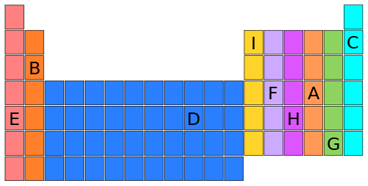
2. Which elements are similar?
•Columns are called groups or families.
•Rows are called periods.
•Families may be one column, or several columns put together.
•Families have names rather than numbers. (Just like your family has a common last name.)

Slide 4
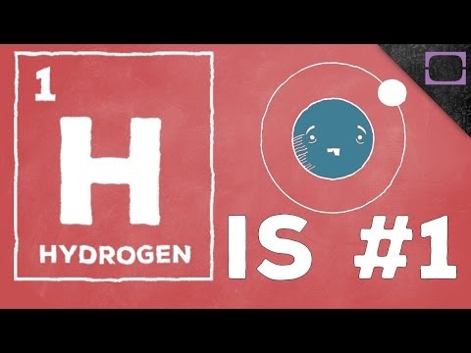
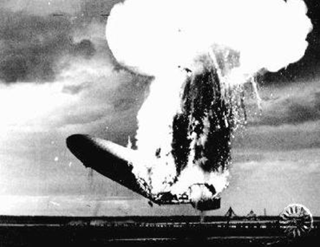
Hydrogen Family (black)
•Hydrogen is a family of 1.
•Hydrogen is a diatomic, reactive gas.
•Hydrogen was involved in the explosion of the Hindenberg.
•Hydrogen is promising as an alternative fuel source for automobiles.

Slide 5
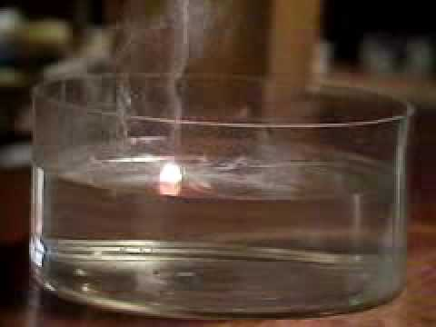
Alkali Metals (light blue)
•1st column on the periodic table (Group 1) -not hydrogen.
•Very reactive metals, always combined with something else in nature (like in salt).
•Soft enough to cut with a butter knife

Slide 6
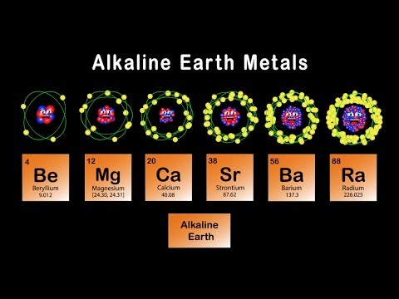
Alkaline Metals (dark blue)
•2nd column (Group 2)
•Reactive metals that are always combined with nonmetals in nature.
•Several of these are important mineral nutrients (Mg and Ca)

Slide 7
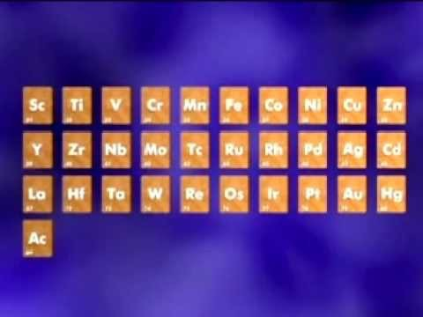
Transition Metals (purple)
•Groups 3-12
•Less reactive harder metals
•Includes metals used in jewelry and construction.
•Metals used “as metal.”

Slide 8

Boron (light green)
•Group 13
•Aluminum metal was once rare and expensive, not a “disposable metal.”
•Currently is the most widely used metal in the U.S.

Slide 9
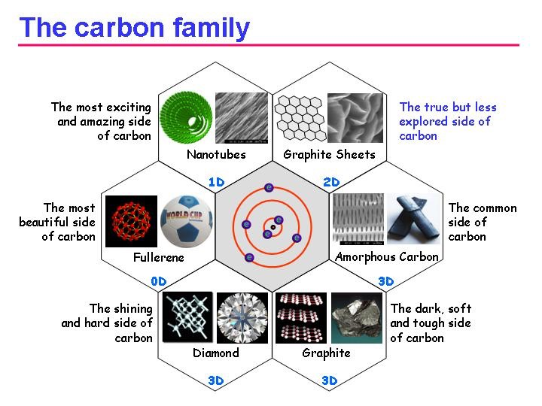
Carbon (dark green)
•Group 14
•Contains elements important to life and computers.
•Carbon is the basis for an entire branch of chemistry, called organic chemistry.
•Silicon and Germanium are important semiconductors.

Slide 10
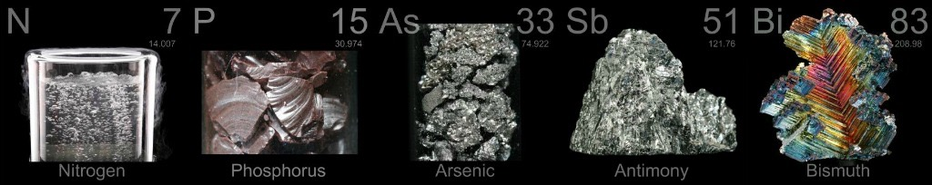
Nitrogen (yellow)
•Group 15
•Nitrogen makes up over ¾ of the atmosphere.
•Nitrogen and phosphorus are both important in living things.
•The red stuff on the tip of matches is phosphorus.

Slide 11
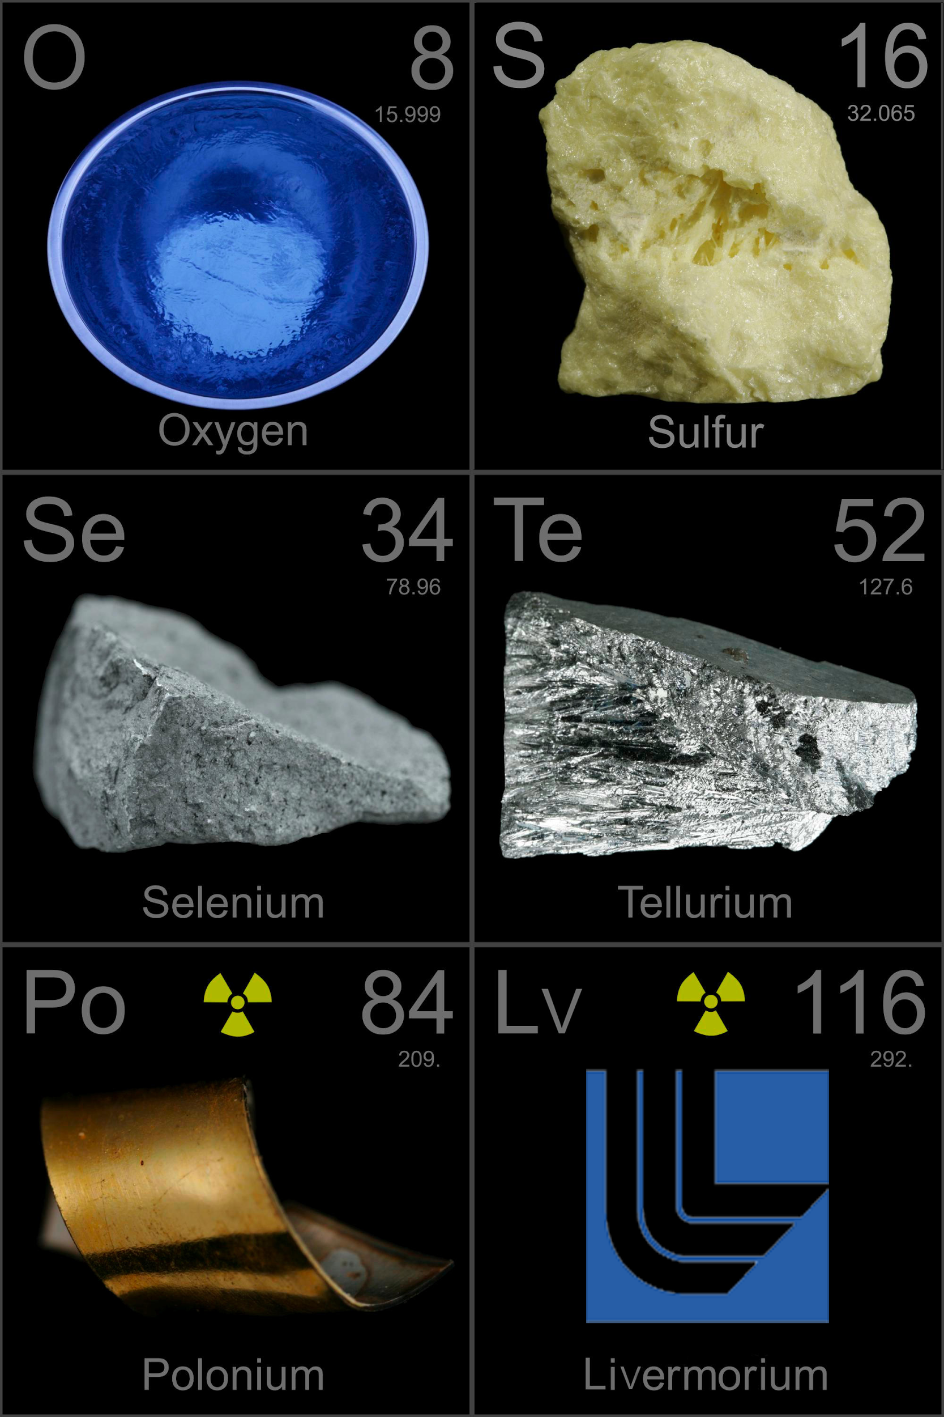
Oxygen (orange)
•Group 16
•Oxygen is necessary for respiration.
•Many things that stink, contain sulfur (rotten eggs, garlic, skunks,etc.)

Slide 12
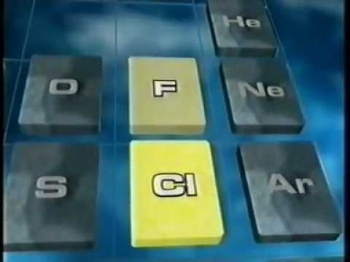
Halogens (red)
•Group 17
•Very reactive, volatile, diatomic, nonmetals
•Used as disinfectants and to strengthen teeth.

Slide 13
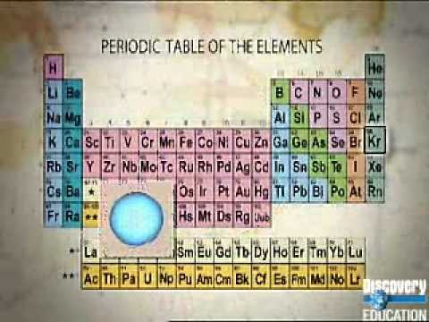
Noble Gases (grey)
•Group 18
•VERY unreactive, monatomic gases
•Used in lighted “neon” signs
•Used in blimps to fix the Hindenberg problem.

Slide 14
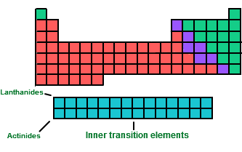
Lanthanides and Actinides (purple)
•Reactive inner transition metals

Slide 15
Closure: Select an element that has similar properties to the one listed.
Argon
Potassium
Chromium

